Slide 1



“Getting to Zero” in San Francisco
Consortium
Zero new HIV infections
Zero HIV deaths
Zero stigma and discrimination
Photo by Jim Herd

Slide 2






















Welcome and Many thanks to our sponsors and to the >200 members for all of their volunteer work!
Steering Committee
Susan Buchbinder
David Gonzalez
Diane Havlir
Joe Hollendoner
Tracey Packer
Jenna Rapues
Hyman Scott
Jeff Sheehy
Chip Supanich
Lance Toma
Shannon Weber
Dana van Gorder
Rafael Velazquez

Slide 3
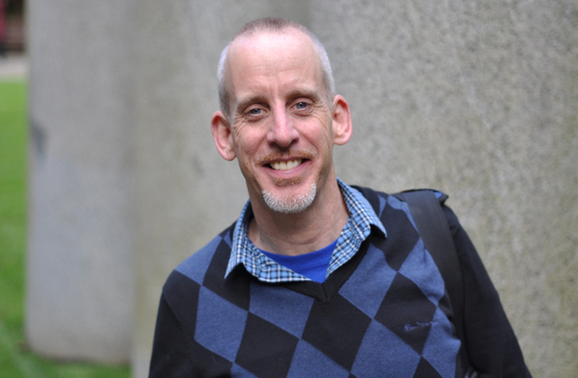
Dave Robb

Slide 4
Agenda
Welcome and San Francisco Numbers – Barbara Garcia
Getting to Zero Consortium and Acknowledgments
Committee Chair Panel & Discussion
Panel Presentation & Discussion: HIV & Aging

Slide 5
HIV in San Francisco: 2015
Progress is being made in several areas:
  New HIV infections declined 17% from 309 in 2014 to 255 in 2015
  93% of all people living with HIV in San Francisco are aware of their infection
  People living with HIV are being linked to care more quickly
    Average time from diagnosis to full viral suppression dropped to 3 months in 2015
But, substantial disparities remain
  The rate of new HIV diagnoses are highest in African American men (140/100,000 population), followed by Latino (83/100,000) and White (52/100,000) men
  While the rate of new HIV diagnoses are lower in women than men, they are substantially higher in African American women (31/100,000) than Latina (8/100,000) or White (5/100,000) women
  Mortality rates are also higher in African Americans than other racial/ethnic groups

Slide 6
Getting to Zero SF: What are we?
Multi-sector independent consortium– operates under principles of collective impact:
  “Commitment of groups from different sectors to a common agenda to solve a specific problem.”
Vision
  Become the first municipal jurisdiction in the United States to achieve the UNAIDS vision of “Getting to Zero”
  Zero new HIV infections
  Zero HIV related deaths
  Zero stigma

Slide 7
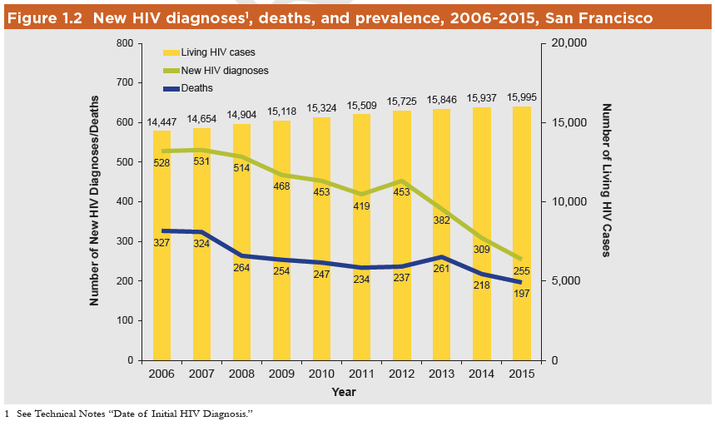
San Francisco: New HIV Diagnosis, Living HIV cases and Deaths
Universal ART
15,995 living with HIV
255 new diagnosis (17% decline)
197 deaths
PrEP
GTZ

Slide 8
Strategic Plan: Signature Initiatives
City wide coordinated PrEP rollout
Rapid ART start with treatment hubs
Patient centered linkage, engagement, retention in care
Committee for each initiative + cross cutting ending stigma committee has action plan, metrics and milestones.

Slide 9
GTZ Committee Chairs Panel
Photo by Jim Herd

Slide 10
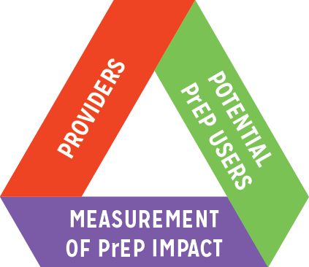









GTZ PrEP Committee
Co-Chairs: Al Liu & Robert Grant
PrEP User Subcommittee Co-chairs: Pierre Crouch & Stephanie Goss
PrEP Provider Subcommittee Co-chairs: Tracey Packer & Stephanie Cohen
PrEP Metrics Subcommittee Chair: Susan Scheer
Members: Oliver Bacon, Halvard Bagoien, Jackson Bowman, Susan Buchbinder, Alyson Decker, Jim Dilley, Edvard Engesaeth, Jonathan Fuchs, Jesus Gaeta, Jayne Gagliano, Ruben Gamundi, Hans Gangeskar, Ron Goldschmidt, Robert Grant, Brad Hare, Geoff Hart-Cooper, Jen Hecht, Mike Hickey, Anne Hirozawa, Alison Hughes, Cait Koss, Skot Land, Adam Leonard, Montica Levy, Paul Marcelin, Julia Marcus, Erick Martinez, John Melichar, Gavin Morrow-Hall, Austin Nation, Trang Nguyen, Miranda Nordell, Sergio Paz, Susan Philip, Greg Rebchook, Michael Reyes, Darpun Sachdev, Hyman Scott, Matt Sharp, Miriam Sheinbein, Lisa Stern, Eric Tang, Adam Taylor, EB Troast, Paul Urban, Dana van Gorder, Jonathan Volk, Shannon Weber, Sophy Wong

Slide 11

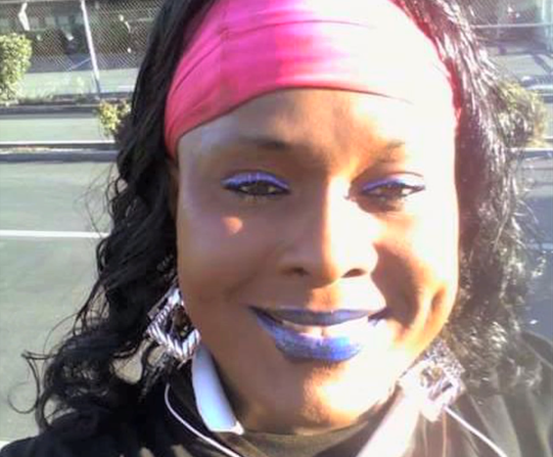


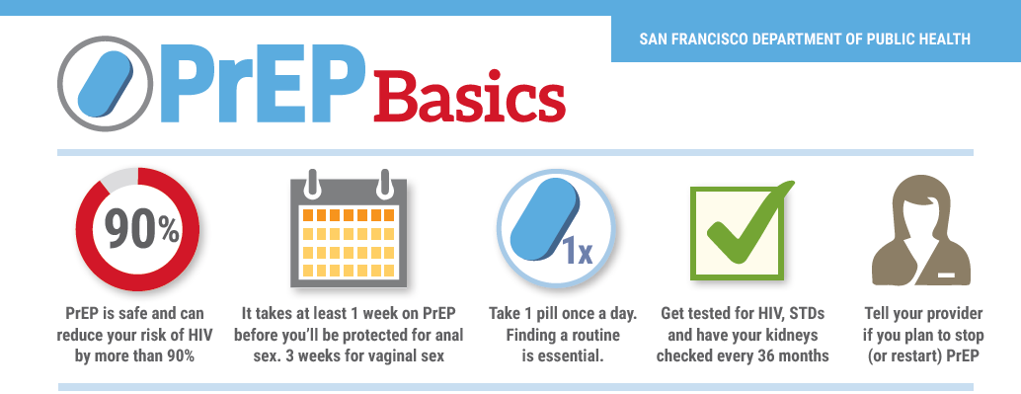
PrEP Achievements/Highlights
Launch PrEP social marketing and digital stories focused on MSM of color and transwomen (PrEP users)
Launch of PrEP public health detailing program (PrEP providers)
Secured grant funding to comprehensively evaluate the PrEP cascade in SF (PrEP metrics)

Slide 12

Notes:
The PrEP Committee would like to show this digital story, ~4:16min.
Diamond's Victory by Diamond Electra Star

Slide 13
RAPID Committee
Co-Chairs: Oliver Bacon, Stephanie Cohen, Diane Havlir
Committee Members: Virginia Cafaro, Darpun Sachdev, Julie Lifshay, Chris Pilcher, Erin Antunez, Sandra Torres, Janet Grochowski, Diane Jones Clarissa Ospina-Norvell, Susa Coffey, Marc Solomon

Slide 14
RAPID Achievements/Highlights
Linkage/Navigation
  Created 1st RAPID Provider Directory and Insurance/Care Navigation guide
  Identified barrier to RAPID linkage for non-medical eligible…working with ZSFGH, SFCC to overcome
  Funding obtained from G2Z for RAPID Linkage Specialist
RAPID Providers
  Pilot Detailing visits suggest early clinician uptake of RAPID
  Funding obtained from G2Z for detailing specialists to accelerate expansion of RAPID providers
Dissemination: CDC, HRSA, Ontario (CAN), Florida, New York City, Oakland, Contra Costa County, Pittsburgh (PA), Atlanta, Baltimore, Australia……
Baseline Metrics
Median Days From: | 2013 | 2014 | Q3 2015*
Diagnosis to Care | 8 | 7 | 7
Care to ART | 26 | 14 | 6
ART to VL<200 | 70 | 49 | 50
Diagnosis to VL<200 | 131 | 88 | 69
*data subj to revision

Slide 15
Retention & Re-engagement Committee
Adam Taylor/supervisor weiner’s office
Adrienne Elias/shanti, sf hiv planning council
Amanda Newstetter/bay area aetc
Andy Scheer/sfdph sf city clinic (co-chair)
Austin Padilla/stigma committee rep.
Beth Mazie/positive resource center
Bill Hirsh/aids legal referral panel
Chip Supanich*/sf hiv planning council
Christy Camp/larkin st. youth
Chuan Teng/positive resource center
Dana Van Gorder*/project inform
Darpun Sachdev/sfdph lincs navigation
Dean Goodwin/sfdph hhs
Edwin Charlebois/ucsf caps (co-chair)
Erin Antunez/sfdph lincs navigation
Eva Mureithi/ucsf w86
*gtz steering committee member
Gale Sandoval/instituto familiar de la raza
Hyman Scott*/sfdph bridge hiv & ucsf w86
Joanna Eveland/sfdph tom waddell
Jae Sevelius/ucsf caps
Joe Ramirez-Forcier/positive resource center
Julie Lifshay/sfaf
Kate Darling/ucsf
Kate Franza/api wellness
Linda Walubengo/catholic charities
Lori Thoemmes/ucsf ahp
Marc Vincent/ucsf
Nikki Calma/shanti
Noah Lopez/project open hand
Susan Scheer/sfdph surveillance
Tanya Mera/sfdph jail health
Tara Apriletti/mnhc clinica esperanza
Tracey Packer/sdfph

Slide 16
R&R Achievements/Highlights
MAC AIDS Fund, LINCS Lessons Learned
  Clinic-based and Surveillance-derived data effective in locating and re-engaging Pts in care; in 9-month period, 120 clinic-based referrals enrolled in LINCS
  Navigation increases viral suppression, supporting TasP biomedical intervention
MAC AIDS Fund, Current Practices Survey
  DPH/Public/Private providers surveyed: majority use pre-appointment reminders (phone/voicemail/SMS) & do missed visit follow-up
  Clinics willing to develop links to programs for re-engagement in care, PrEP and RAPID ART start & linkage to MH & SU Tx resources
Metrics Development: Working group to advance city-wide collection and evaluation of retention and re-engagement metrics (including un-met need) formed & common framework based on revised Medical Monitoring Project (MMP) data collection set. Developing MMP and additional sentinel sites.
Retention & Re-Engagement Toolkit: Content developed; funding secured; moving on to design & distribution phases.
Pharmacy Workgroup: Convened workgroup for leveraging pharmacies for retention & re-engagement collaboration.
Implementation of Y2 Proposals: Employment Services
Intensive Case Management, SF HIV Frontline Workers,
Aging Services, Food Security, Communications

Slide 17
Ending Stigma
Co-Chairs: Austin Padilla & Wayne Steward
Members: Tez Anderson, Bobbi Lopez, Katy Birnbaum,
Cecilia Chung, Talia De La Cruz, Rebecca Erenrich,
Vincent Fuqua, Stephanie Goss, DK Haas, Alison Hughes,
Brandon Ivory, Sam Jackson, Shaddai Martinez-Cuestas,
Mark Molnar, Gavin Morrow-Hall, Thomas Muyunga, Tracey Packer, Marion Pellegrini, Jenna Rapues, Armando Rodriguez, Allison Rojas,
Ashley Rojas, Sabina Simmons, Hanna Tessema,
Lance Toma, Jonathan Van Nuys
Guy Vandenberg, Keith Waltrip, Caroline Watson, Shannon Weber

Slide 18
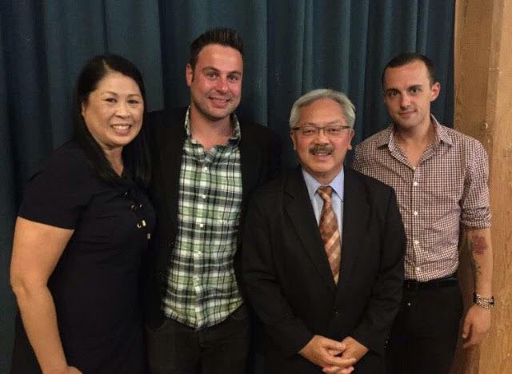
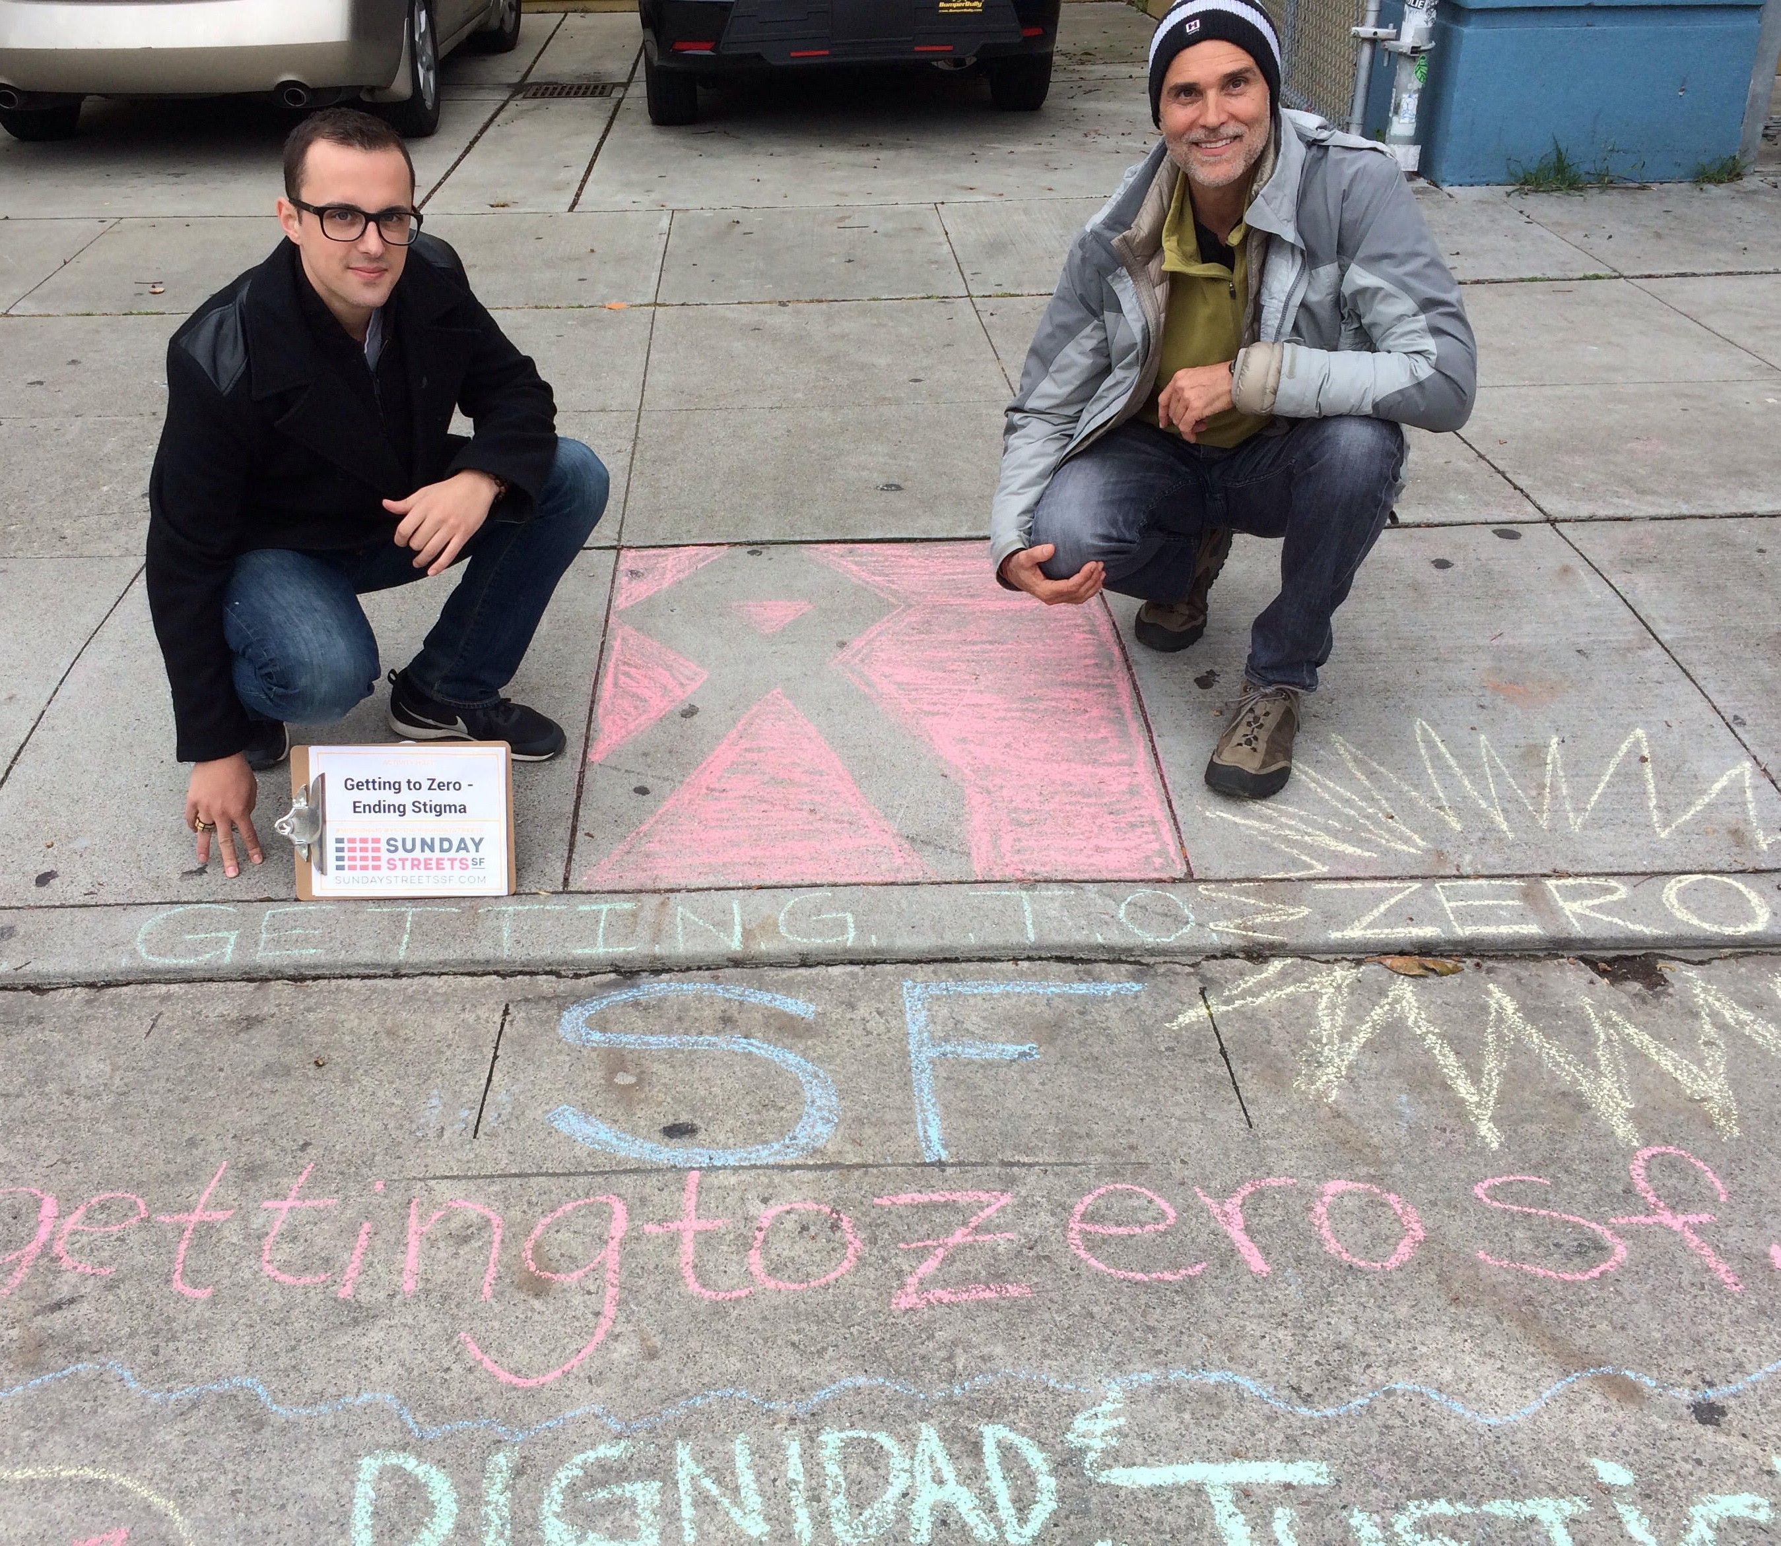
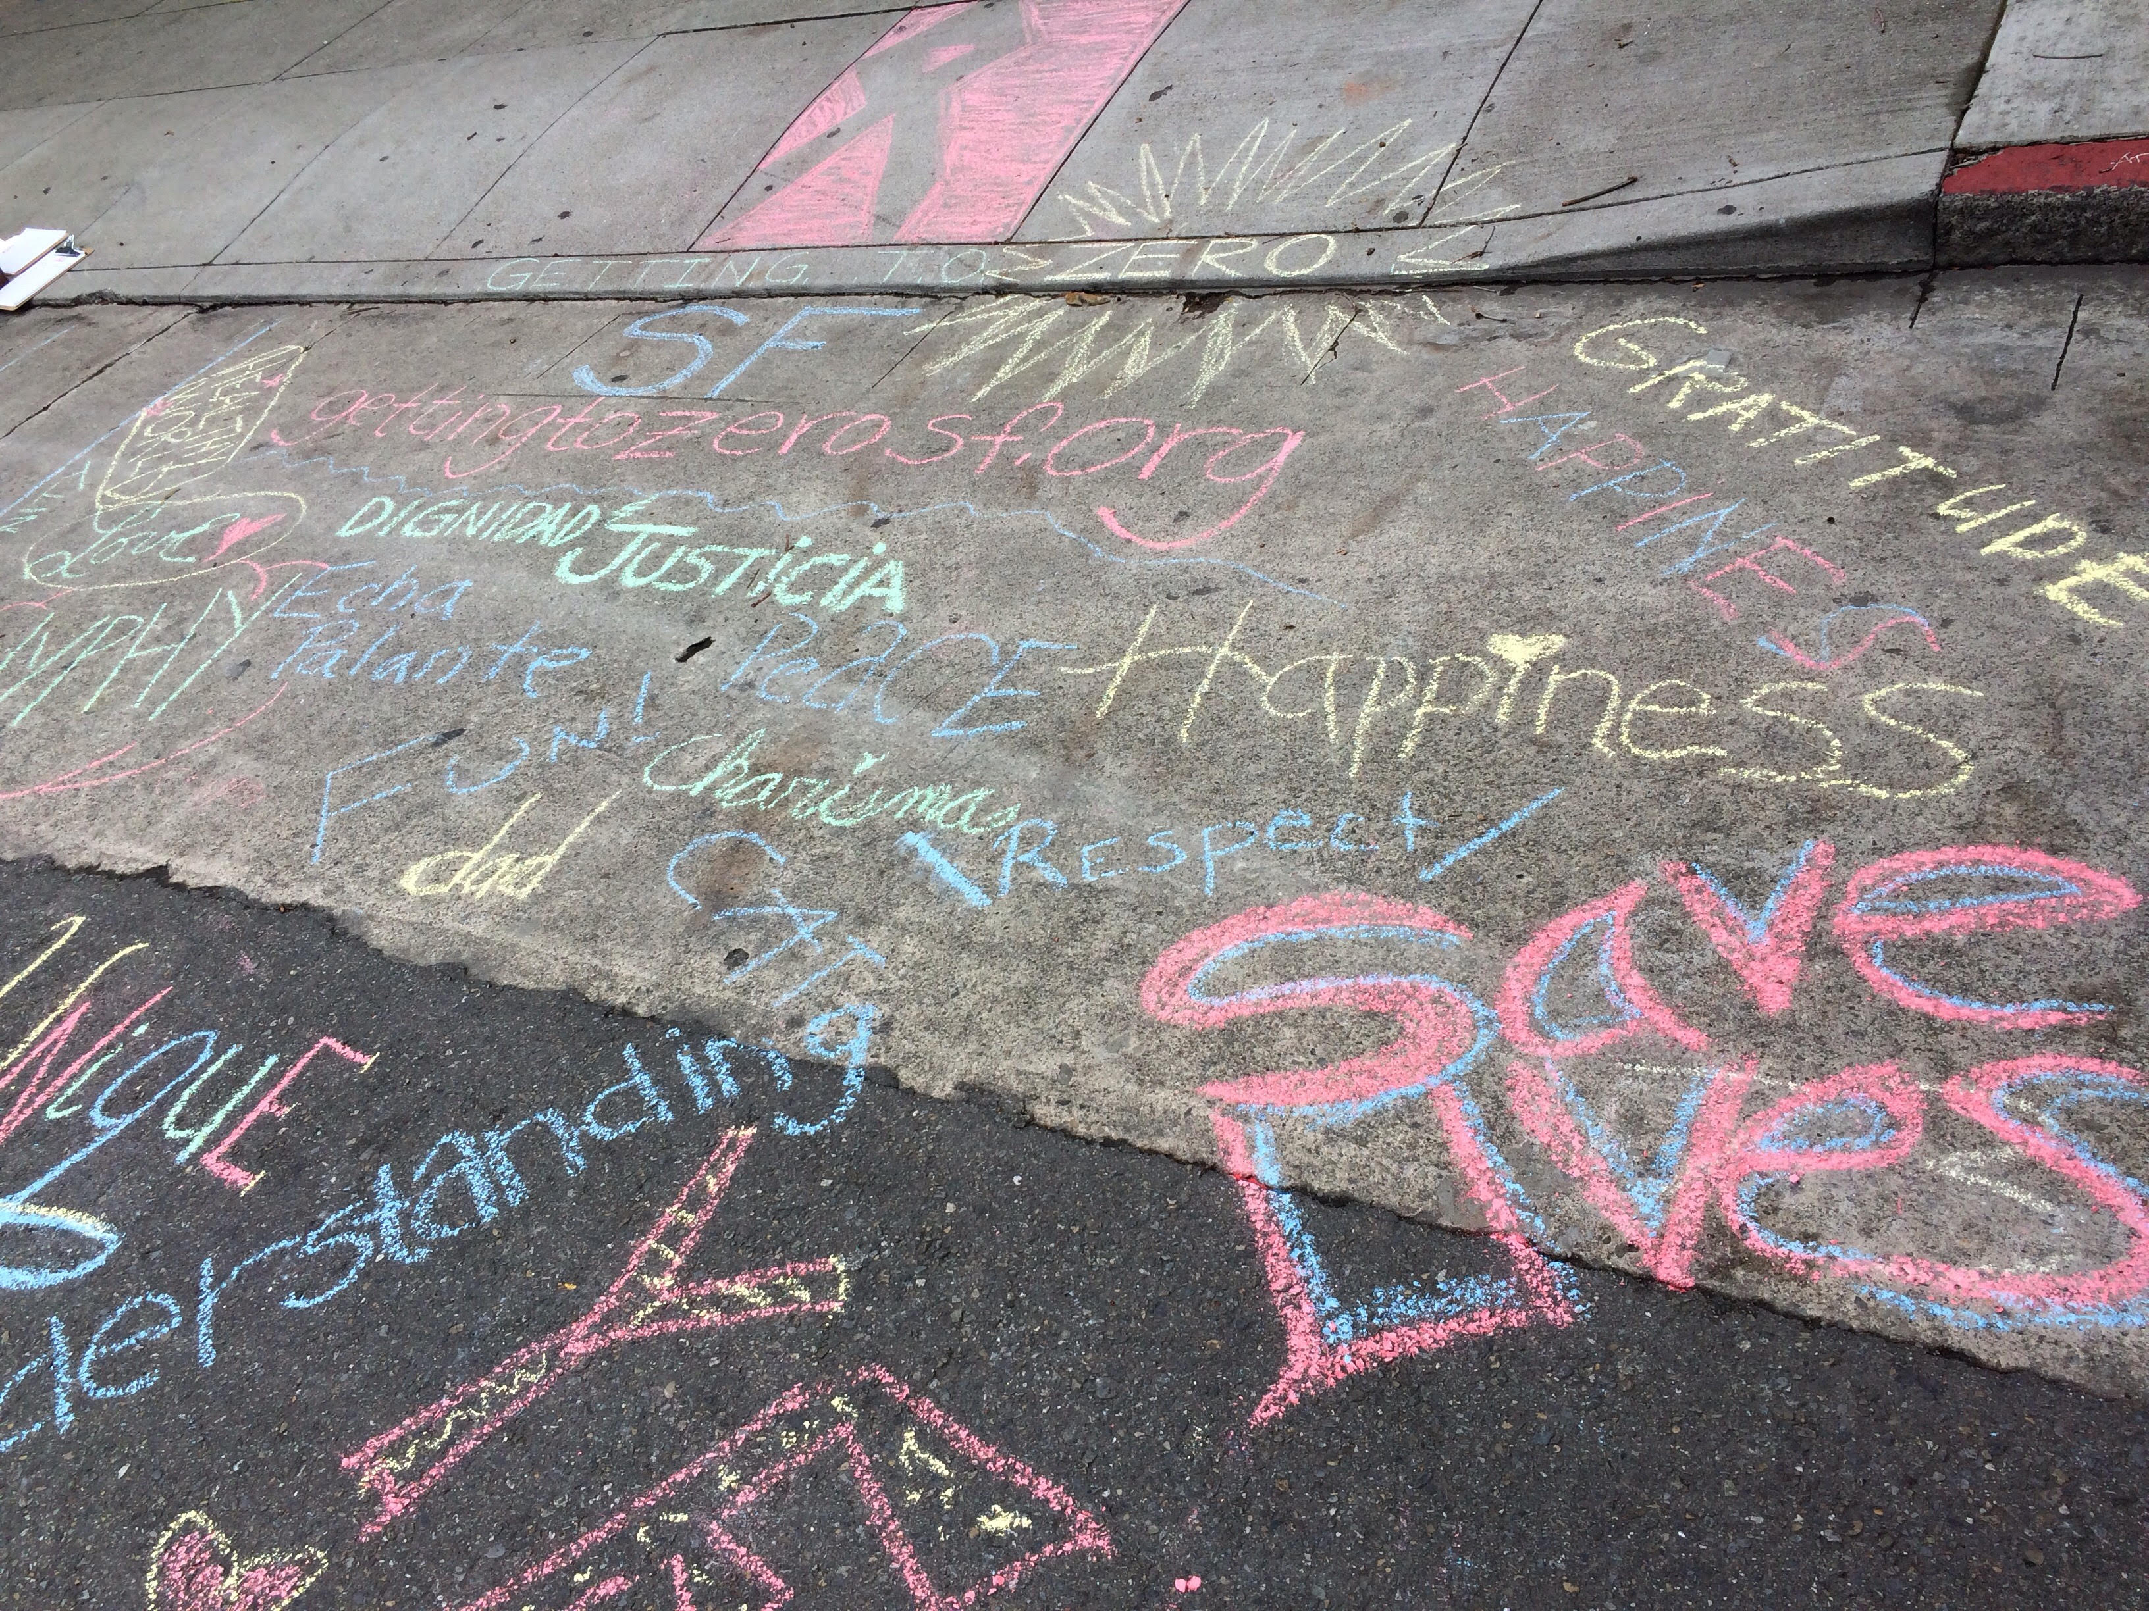
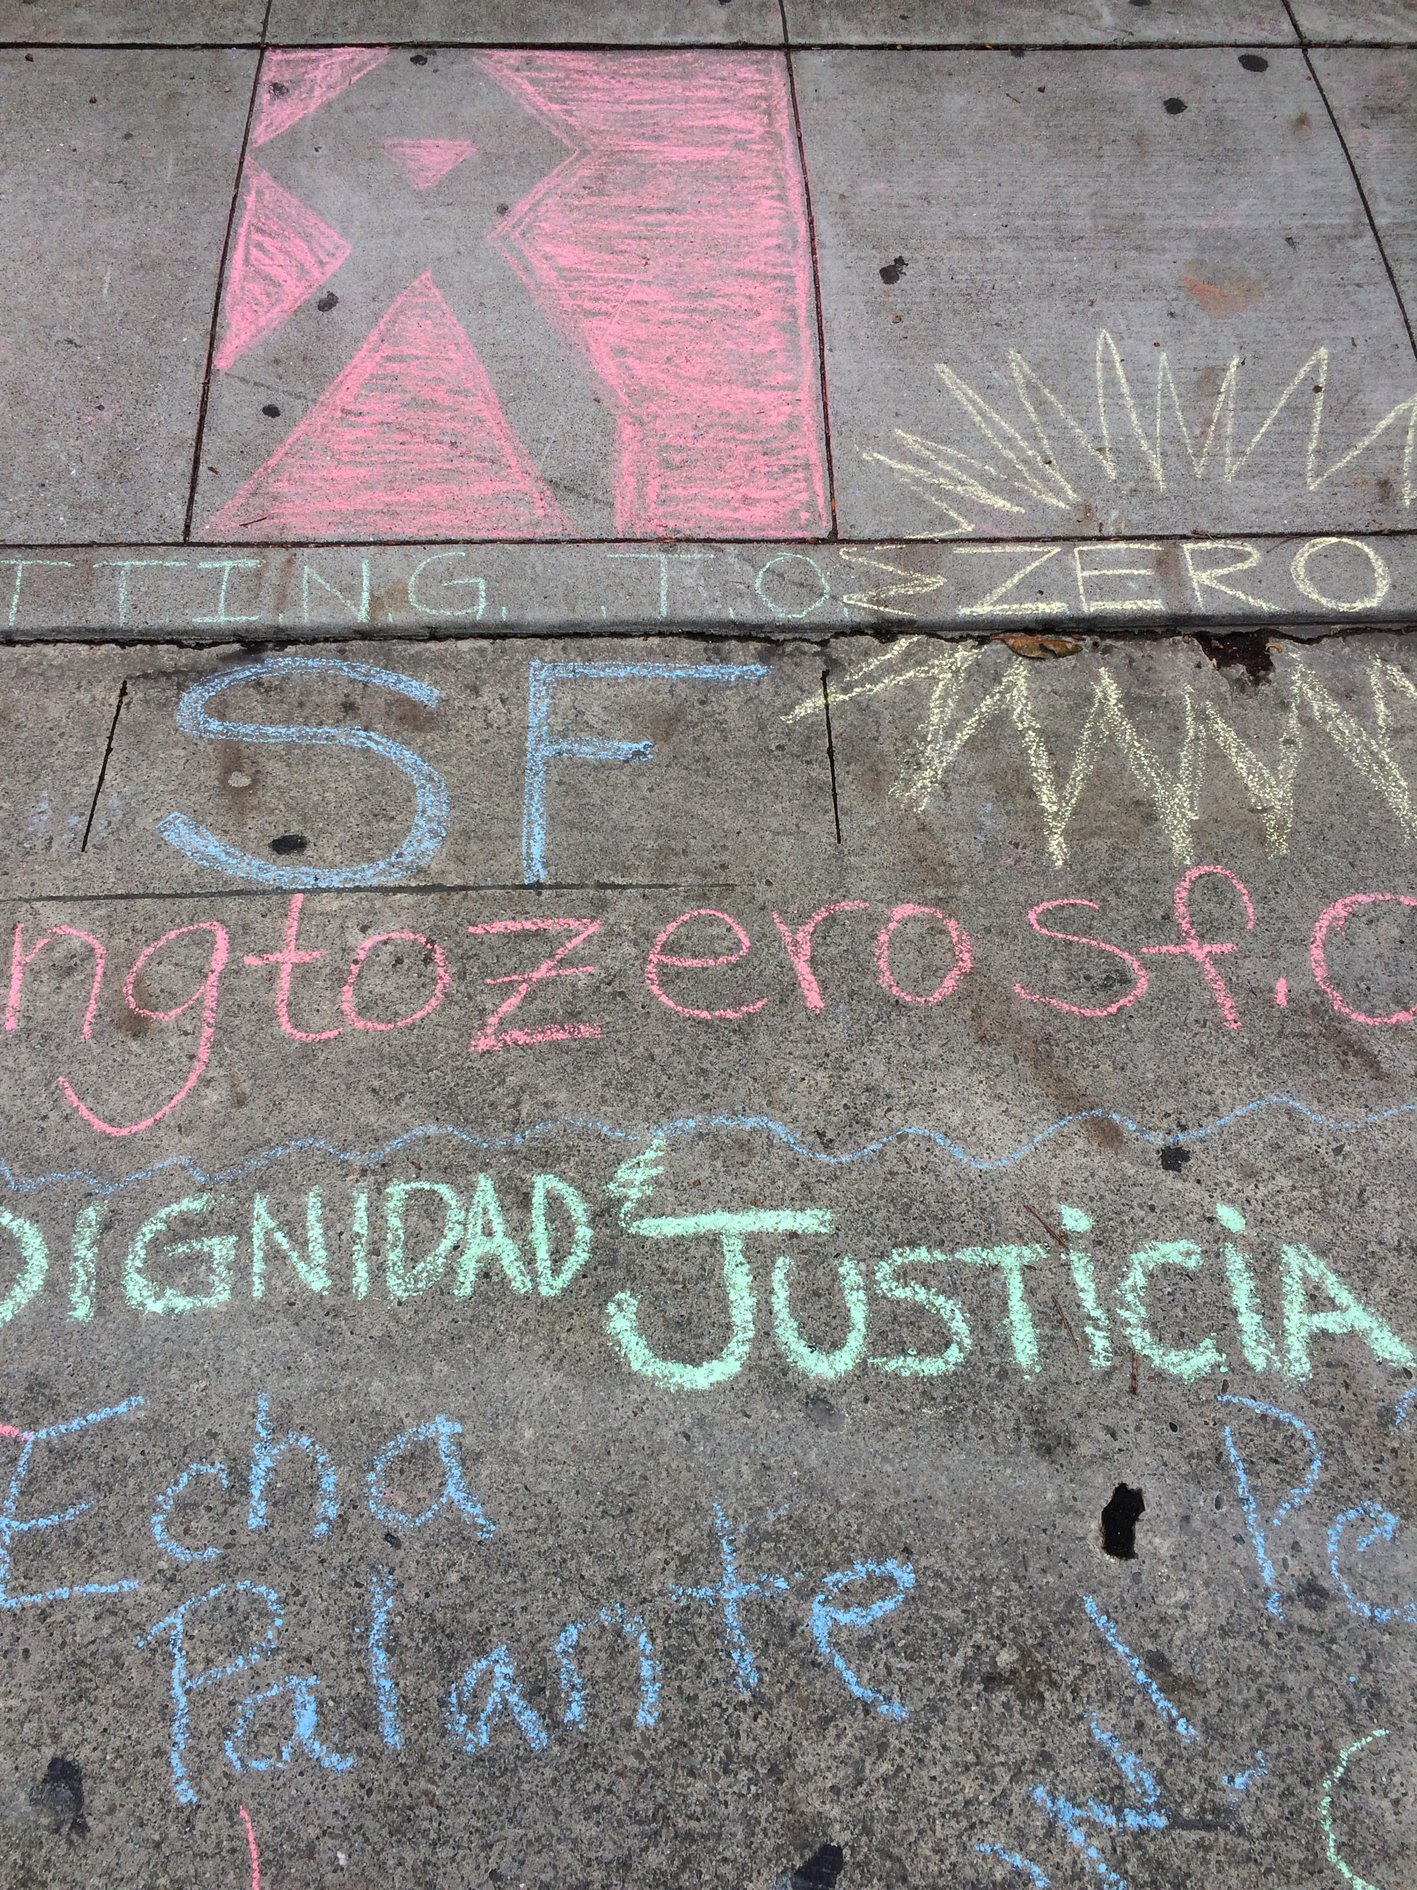
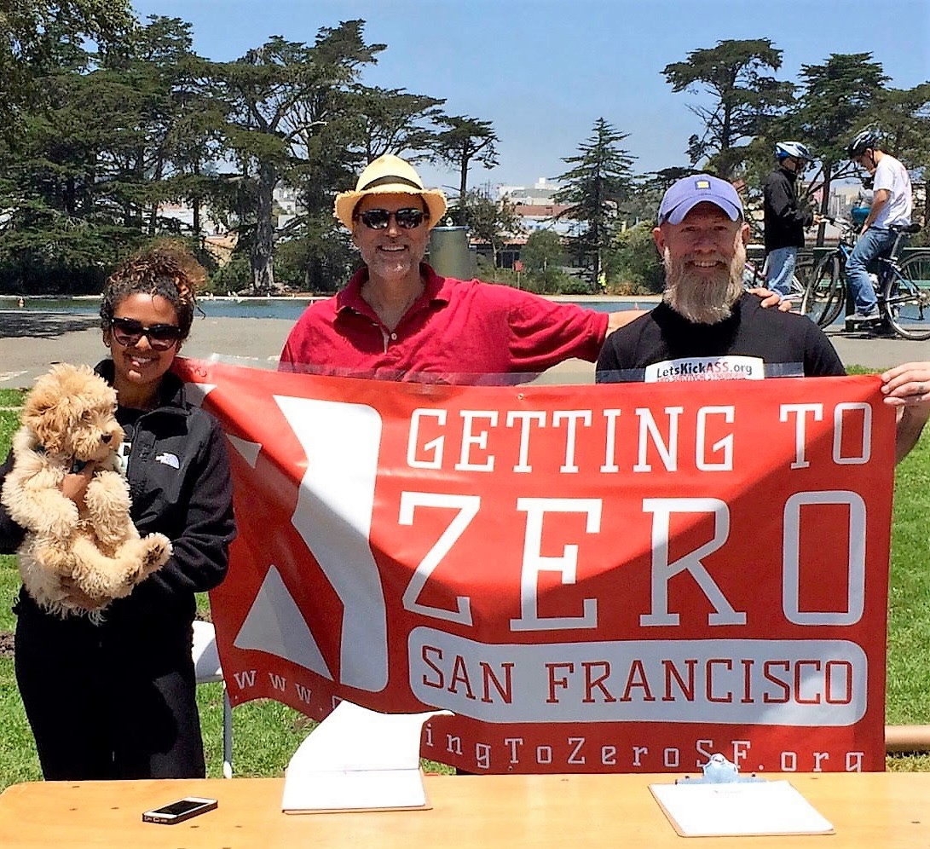
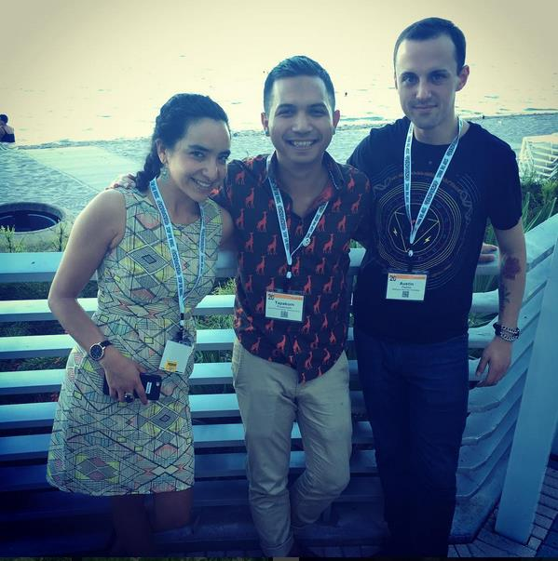
Community Outreach at Sunday Streets
Budget discussions with Mayor Lee
Representation at USCA 2016 in Broward County, FL
Notes:
Share 3 achievements or highlights from past year

Slide 19
Addressing Disparities
Photo by Jim Herd

Slide 20
Aging & HIV Panel
Photo by Jim Herd

Slide 21
HIV and Aging
San Francisco Getting to Zero Consortium
December 1, 2016
Presented By: Chip Supanich, Policy Advocate
chipsupanich@gmail.com
Additional Data Preparation: Kevin Hutchcroft, SFDPH
Kevin.Hutchcroft@sfdph.org
    Kevin Hutchcroft, HIV Health Services, SFDPH 628-206-7676
Kevin Hutchcrofty@sfdph.gov

Slide 22
Percentage of Persons Living with HIV >50 years old, United States
Source: Centers for Disease Control, HIV/AIDS Surveillance Report

Slide 23
Challenges in Caring for the 50+ Population
Health care professionals may underestimate their older patients’ risk for HIV/AIDS and thus may miss opportunities to deliver prevention messages, offer HIV testing, or make an early diagnosis that could help their patients get early care.
Physicians may miss a diagnosis of AIDS because some symptoms can mimic those of normal aging, for example, fatigue, weight loss, and mental confusion. Early diagnosis, which typically leads to the prescription of HAART and to other medical and social services, can improve a person’s chances of living a longer and healthier life.
The stigma of HIV/AIDS may be more severe among older persons, leading them to hide their diagnosis from family and friends. Failure to disclose HIV infection may limit or preclude potential emotional and practical support.

Slide 24
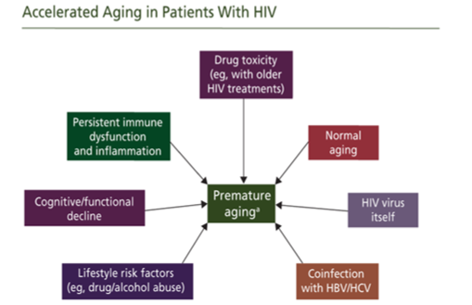

Slide 25
Key Considerations when Caring for
Older HIV-infected Patients
Antiretroviral therapy (ART) is recommended in patients >50 years of age, regardless of CD4 count (Strong recommendation/data from randomized controlled trials) because the risk of non-AIDS related complications may increase and the immunologic response to ART may be reduced in older HIV-infected patients.
ART-associated adverse events may occur in older HIV-infected adults than in younger HIV-infected individuals. Therefore, the bone, kidney metabolic, cardiovascular, and liver health of older HIV-infected adults should be monitored closely.
The increased risk of drug-drug interactions between antiretroviral (ARV) drugs and other medications commonly used in older HIV-infected patients should be assessed regularly, especially when starting or switching ART and concomitant medications.
HIV experts and primary care providers should work together to optimize the medical care of older HIV-infected patients with complex comorbidities.
Counseling to prevent secondary transmission of HIV remains an important aspect of the care of the older HIV-infected patients.
    DHHS. Available at: http:aidsinfo.nih.gov/ContentFiles/AdultandAdolescentGL.pdf

Slide 26
Emerging Issues: Psycho-social
Mental health
Long-term & emerging substance use
Increased social withdrawal & isolation
Age-ism is yet another “ism” exacerbating stigma, discrimination & low self-esteem
Increasing economic hardship & financial instability
Increasing complexity of healthcare
benefits & insurances
Increasing need for legal & other support
Housing remains a commanding issue

Slide 27
Barriers & Systemic Challenges to Care
Awareness of available services and benefits
  Problems Navigating System of Services
  Benefits Counselors rarely know all of the issues regarding Benefits for older adults-Ryan White, Medicare (esp. Part D), Medi-Cal, SSI/SSDI/SS Retirement, LTD, etc.
Eligibility for services and benefits
  Middle Income individuals have problems obtaining certain services/medications
  Approximately 7% of 50+ population is homeless at time of HIV/AIDS diagnosis
Expressed need for programs that target this population
Funding for HIV/AIDS from federal, state and local resources are decreasing which makes it difficult to consider developing new programs
Need to make programs that exist for the older population more accessible for people living with HIV/AIDS and sensitive to their unique needs
Need to develop age sensitivity for current HIV/AIDS Providers

Slide 28
Thank You

Slide 29
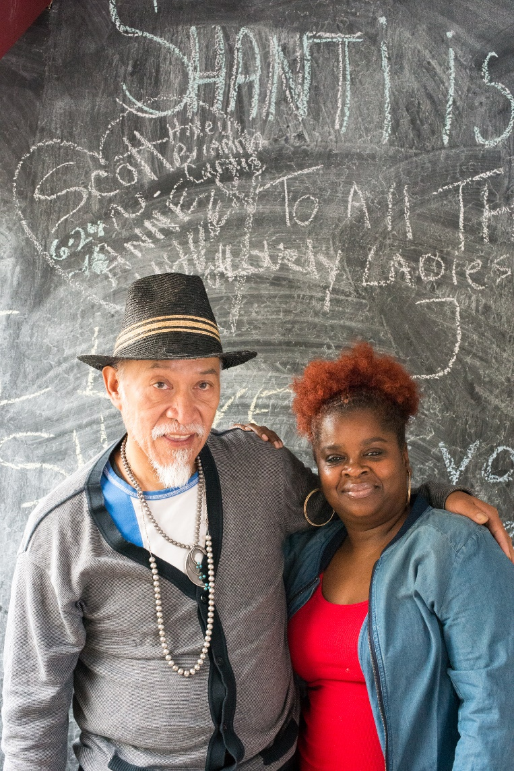
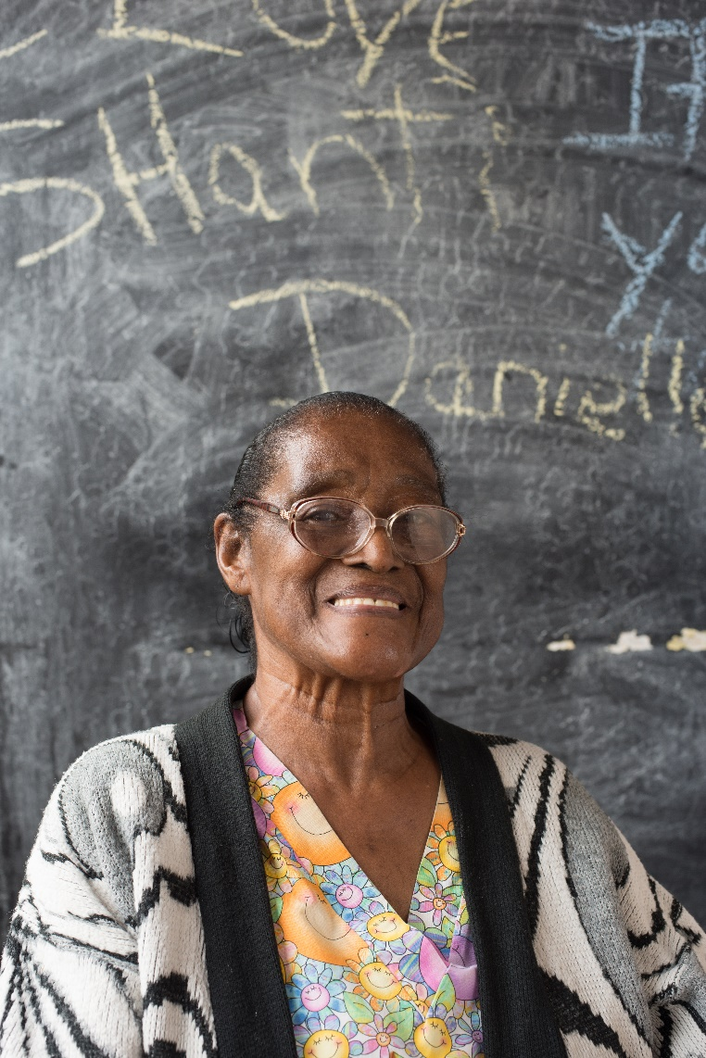

HIV/AIDS & Aging
Shanti Project’s Executive Director, Kaushik Roy

Slide 30

Shanti Project History
Founded in 1974 by Dr. Charles Garfield at the UCSF Cancer Institute in San Francisco.
One of the first community-based agencies to work with terminally-ill people and became one of the first AIDS Services Organizations in the world.
Shanti has trained over 18,000 volunteer caregivers in the Bay Area and over 600 organizations world-wide in the Shanti Model of Peer Support™.
For many of Shanti’s 2,500 annual clients, Shanti represents the difference between zero and one -- the difference between a client having to face a life-threatening illness alone or having at least one caring presence at his or her side.

Slide 31
Shanti’s HIV+ Clients Served by Age Range

Slide 32
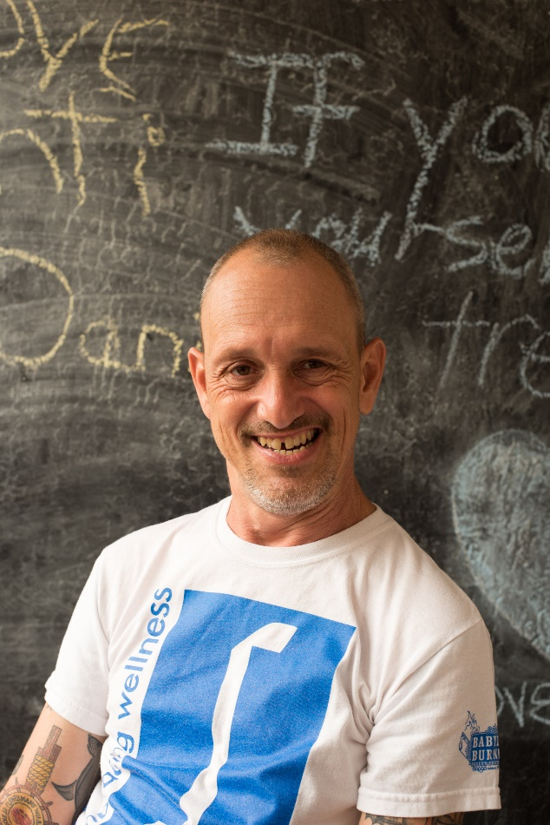
Shanti Services available to Seniors living with HIV
Care Navigation/Client Advocacy - Thanks to funding from SF DPH and the Ryan White Care Act, Shanti now has a Care Navigator specifically focused on serving seniors with HIV. Care navigation includes emotional and practical support, volunteer matching, support with treatment adherence, harm reduction-based counseling, and assistance with linkage to other service providers.
L.I.F.E.® Program – L.I.F.E. ® is an evidence-based, health-enhancement program for HIV positive individuals.
Senior Support Group - Shanti’s Positive Seniors group meets weekly to discuss and process issues specific to seniors living with HIV.
Activities Desk – Activities offers Shanti clients an opportunity to enjoy some of the Bay Area’s interesting activities and events while socializing and establishing connections with their peers.

Slide 33
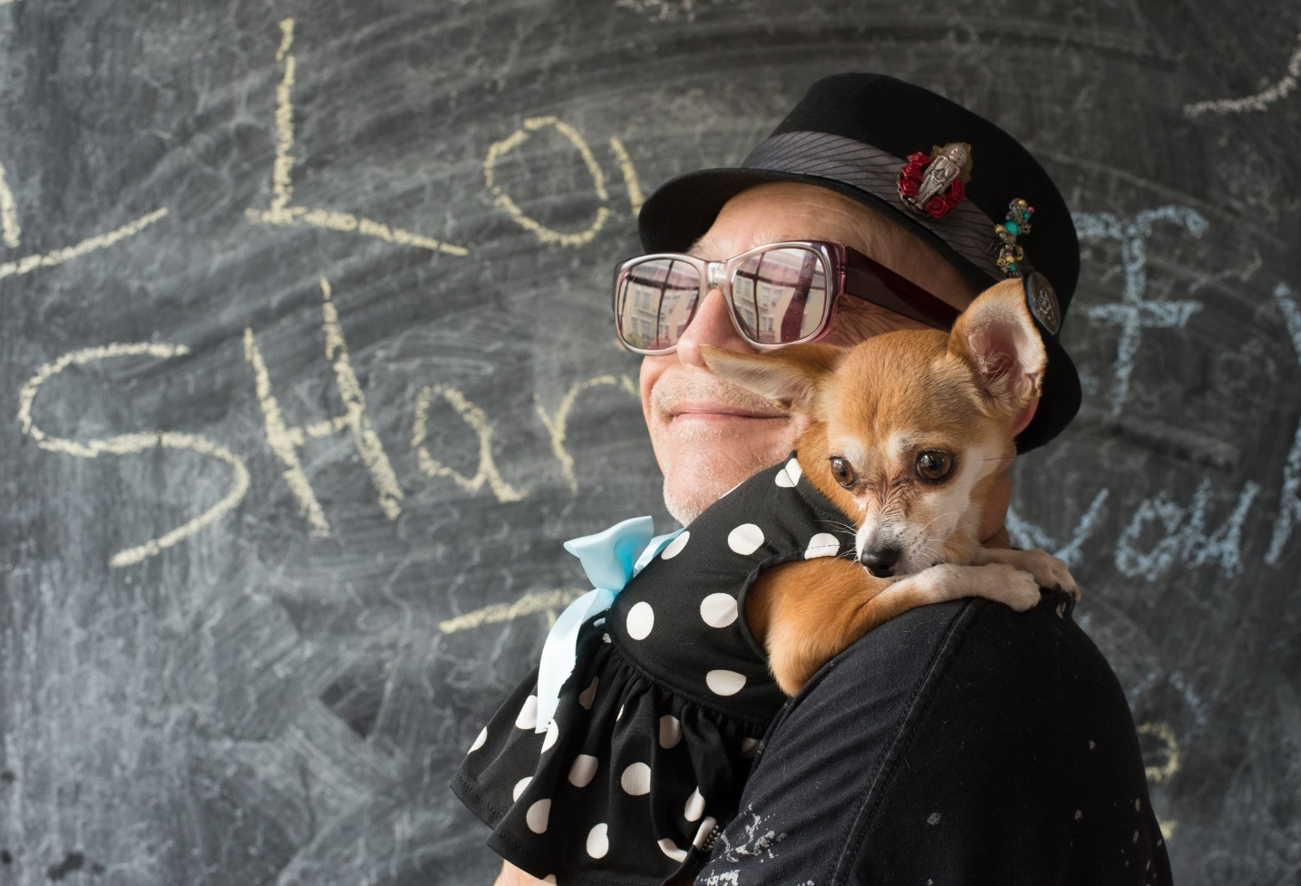
Shanti Services available to Seniors living with HIV (Continued)
PAWS – A program dedicated to preserving the human/animal bond through a variety of programs, including a food bank, dog walking and Care Navigation.
Shanti Peer Support Volunteers – A program to help reduce isolation by providing emotional and practical support to seniors living with HIV. Each volunteer goes through Shanti’s 25 hour Peer Support Training.
    Honoring Our Experience - A biannual weekend retreat for long-term survivors of HIV to connect and build community.
Revival - A quarterly event that provides opportunities for participants to socialize, connect and dance the night away!
Activities Group - Shanti’s Activities Program has a monthly outing group specifically for seniors with HIV to break isolation and build community.

Slide 34
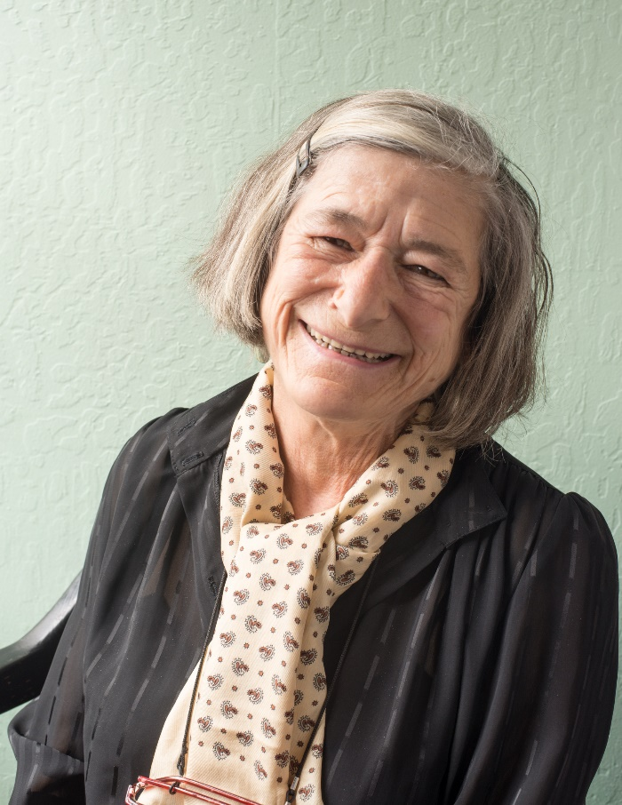
Shanti and the Aging Population of San Francisco
Shanti was awarded a contract from San Francisco’s Department of Aging and Adult Services to launch a program dedicated to reducing isolation amongst LGBT Seniors in San Francisco regardless of health status.
Shanti is continuing to create and expand programming and services specifically designed for senior clients.
Currently 18% of San Francisco residents are over the age of 60.
21% of San Francisco residents will be over the age of 60 by 2020.
For more information about Shanti Project and its programs please contact:
Deputy Executive Director, Mike Hickey at mhickey@shanti.org 415-674-4716
HIV Programs Director, Eric Sutter at esutter@shanti.org 415-674-4754

Slide 35



A PROGRAM OF SAN FRANCISCO AIDS FOUNDATION
vcrisostomo@sfaf.org
415-217-9128
GETTING TO ZERO
DECEMBER 1, 2016

Slide 36
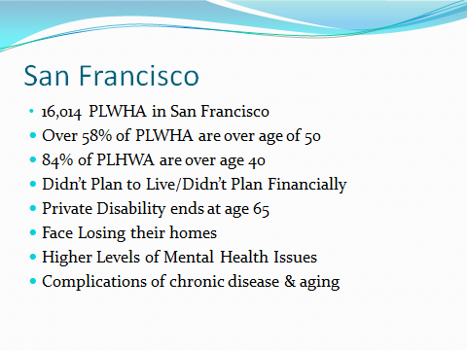

Slide 37
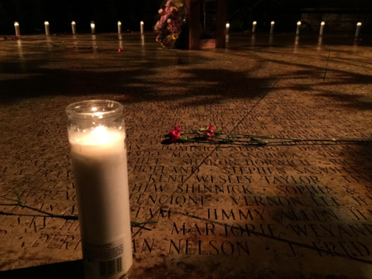
A Wellness Network for Gay/Bi/Trans Men 50 Years & Older who identify as:
Long-Term Survivors of the AIDS Epidemic
Either HIV+ or HIV-
Newly-Diagnosed with HIV.
Isolated in Our Community

Slide 38
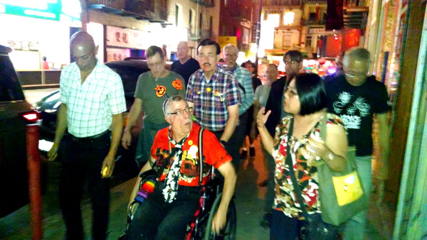
There are five program components that provide a “menu of opportunities” for members:
to improve their own well-being as older gay, bi, or trans men
to provide a helping hand to their peers
to contribute to enhancing their community

Slide 39
Menu of Opportunities
Share and Support: SAS Groups
Making A Difference (MAD Projects)
Connecting: Social Events & Activities
Wellness Coaching: How Am I Doing?
Wellness Advocates: Peer Support

Slide 40
WHERE DO WE GO FROM HERE?
What’s Working…
  EXPANDING OUR CONNECTIONS through SFAF program partnerships: Bridge Men & Positive Force
  ADVOCATING FOR OUR NEEDS (Housing, Income, Wellness/Treatment)
  REDUCING ISOLATION
  EMPLOYMENT/INCOME SUPPLEMENTATION
  Planning – “Come What May…”
  ENVISIONING the Future We Create by the CHOICES we make today
  FINDING MEANING & PURPOSE BEYOND PRESENT CIRCUMSTANCES

Slide 41
References
California Office of AIDS, AIDS Surveillance Report, (June 2014) [http://www.cdph.ca.gov/programs/aids/Documents/June_2014_SemiAnnualReport.pdf]
SAGE: Services and Advocacy for LGBT Elders (2014). Out & Visible: The Experiences and Attitudes of LGBT Older Adults, Ages 45-75. [http://www.lgbtagingcenter.org/resources/resource.cfm? r=695#sthash.nG8nSLhS.dpuf]
Fredriksen-Goldsen, K. I., Kim, H.-J., Emlet, C. A., Muraco, A., Erosheva, E. A., Hoy-Ellis, C. P., Goldsen, J., Petry, H. (2011). The Aging and Health Report: Disparities and Resilience among Lesbian, Gay, Bisexual, and Transgender Older Adults. Seattle, WA: Institute for Multigenerational Health. [http://caringandaging.org/wordpress/wp-content/uploads/2011/05/Full-Report-FINAL-11-16-11.pdf]
LGBT Aging at the Golden Gate: San Francisco Policy Issues and Recommendations (March 2014). [http://sf-hrc.org/sites/sf hrc.org/files/LGBTAPTF_FinalReport_FINALWMAFINAL.pdf]
HIV Epidemiology Annual Report 2013, San Francisco Department of Public Health HIV Epidemiology Section. [https://www.sfdph.org/dph/files/reports/RptsHIVAIDS/ HIVAIDAnnlRpt2013.pdf]

Slide 42
VINCE CRISOSTOMO
Program Manager
415-217-9128 vcrisostomo@sfaf.org
Strut
470 castro street
San Francisco CA 94114

Slide 43
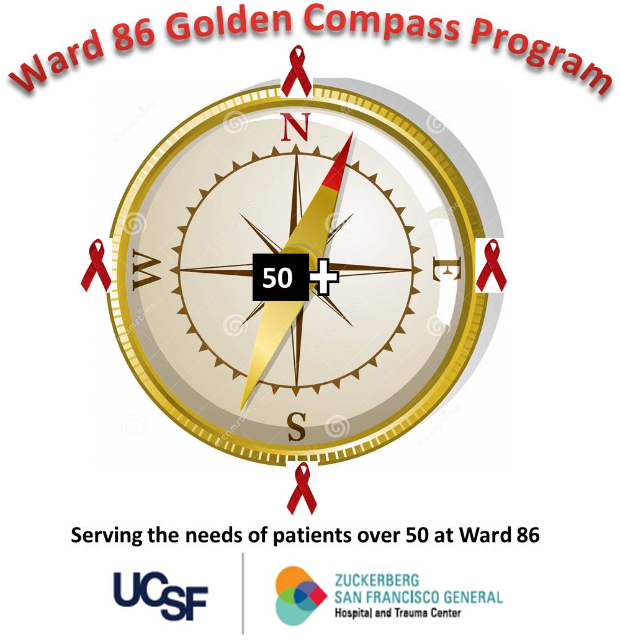

Diane Havlir MD– Chief, Division of HIV, Infectious Diseases, and Global Medicine
Monica Gandhi MD, MPH- Medical Director
Meredith Greene MD- Associate Medical Director (Geriatrician)
Mary Shiels RN – Head RN for initiative

Slide 44
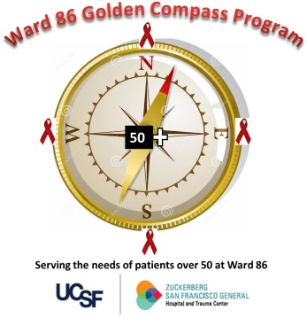
Why this program exists
We know the statistics (60% of people living with HIV in SF >50; new diagnoses common in this age group; comorbidities like cardiologic, neurocognitive, bone health, frailty) but what should we do about it?
So much of HIV movement started here, we need to be at forefront of HIV and aging as a community
Lot of resilience in this community to build upon!

Slide 45
1st step: Focus groups
Older patients at Ward 86
Want services centralized – Optho, Audiology, Dentistry, Cardiology, bone, neuropsych
Want to learn from each other
Want strength and memory classes
Want social support and groups
Came up with Golden Compass name (navigation through Golden years)

Slide 46
How does Golden Compass fit into GTZ?
San Francisco is on track to become the first city to “Get to Zero” in terms of new HIV infections.
As San Francisco works toward this goal, we also need to continue to improve care for people living with HIV today.
With pilot funding provided by AIDS Walk San Francisco, Ward 86 is will launch the Golden Compass Program January 6, 2017, an initiative designed to “Helping people living with HIV navigate their golden years and live well with HIV”

Slide 47
4 points of the program like a compass

Slide 48


NORTH
Heart and Mind
Specialty medical care at Ward 86 for conditions that may differentially affect older patients with HIV.
Introduction of a bimonthly Cardiology Clinic and a designated weekly Psychiatry and Memory Clinic.

Slide 49
EAST
Bones and Strength
Directed by an HIV-trained Geriatrics specialist (Dr. Meredith Greene). Focus on
  Issues of frailty in older HIV-infected patients and how to increase safety and strength
  Reduced bone density mass in older patients and how to strengthen bones through exercise and medications
  Management of neuropathic or other pain syndromes in older patients; and provision of regular fitness activities (such as Yoga, taichi)

Slide 50
WEST
Dental, Hearing and Vision
We will facilitate these important services for our patients including
  Regular Optometry clinic on site for vision checks, eye health checks and glasses
  Facilitation of linkage to Audiology and Dental services

Slide 51
SOUTH
Network and Navigation
Social networking for our patients, with food and activities provided on a monthly basis
We will hold regular peer support groups, with a social work associate where peers and the associate will help navigate members to resources throughout the city (in fitness, eye health, pain management, orthopedics, etc.).

Slide 52
Launch date
Launch date: (soft)
Start with Ward 86 patients and, like RAPID, will harness GTZ community to refine systems, get feedback, disseminate city-wide
January 6, 2017

Slide 53


Photo by Jim Herd

Slide 54
Aging & HIV: Community Discussion
Barriers/Challenges/Gaps
Strategies for success/What works
Questions that remain
Ideas, next steps
Photo by Jim Herd

