Slide 1
HIV Epidemiology Annual Report 2015
Susan Scheer, PhD, MPH
Director, HIV Epidemiology Section
ARCHES Branch
Strategies to Address Disparities
Hyman Scott, MD, MPH
Medical Director, Clinical Research
Bridge HIV

Slide 2
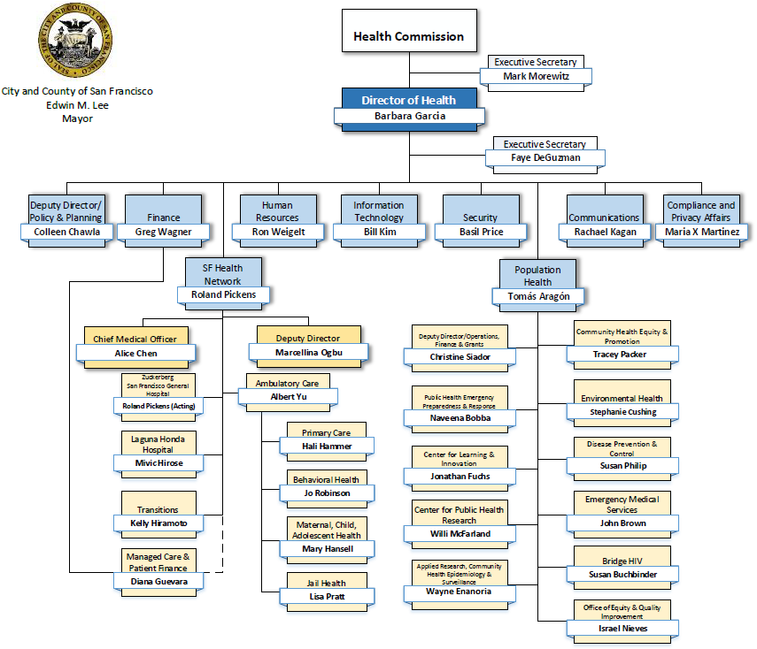

Slide 3
Outline
Key highlights from the recently released HIV Epidemiology Section’s 2015 Annual Report including trends in key indicators
  Encouraging trends on the population level
    Overall declines in new HIV diagnoses
    Declines in deaths and late diagnoses
    Care and treatment items along the HIV care continuum
  Not all San Franciscans have experienced the same improvements; significant health disparities identified
    By race/ethnicity, particularly African-Americans, in treatment and care outcomes, survival and new diagnoses
    Gender disparities in survival and viral suppression
    People who are homeless have very low engagement care and viral suppression
Efforts by Getting to Zero to Address Identified Disparities
    Supporting the existing HIV prevention, care, and treatment programs.
    Emphasis on achieving health equity through innovative programs with measurable objectives.

Slide 4
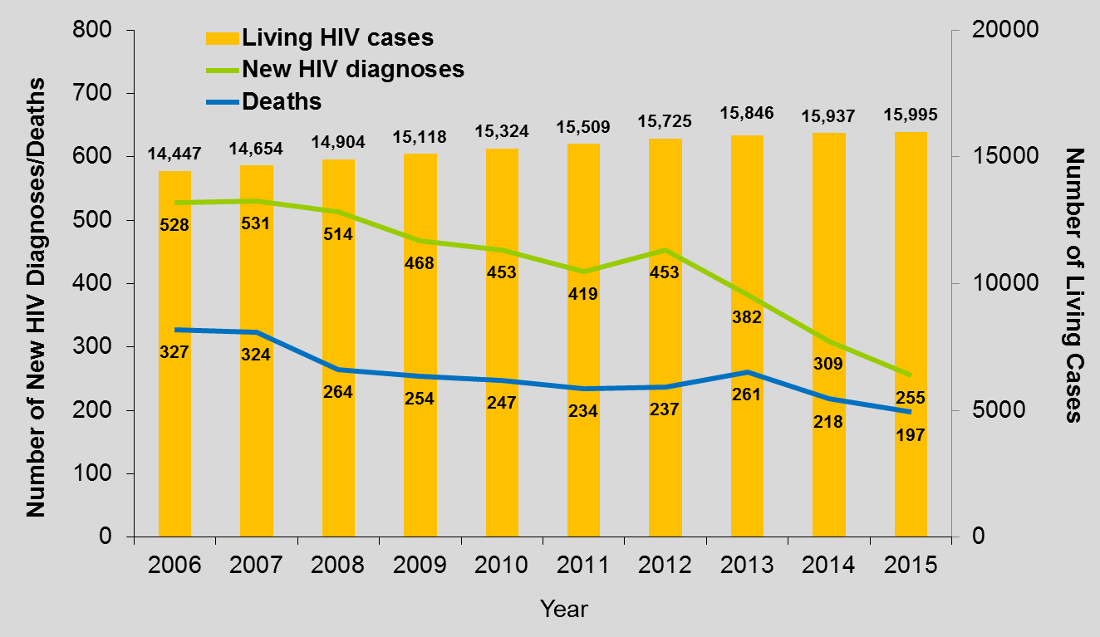
Encouraging Trends among Persons living with HIV and New diagnoses
Overall 93% of PLWH are aware of their HIV status
New diagnoses decreased 17% between 2014-2015
Number of deaths is leveling
Survival is improving; 60% of PLWH >50yrs
Late diagnoses declined from 21% in 2012 to 16% in 2015

Slide 5
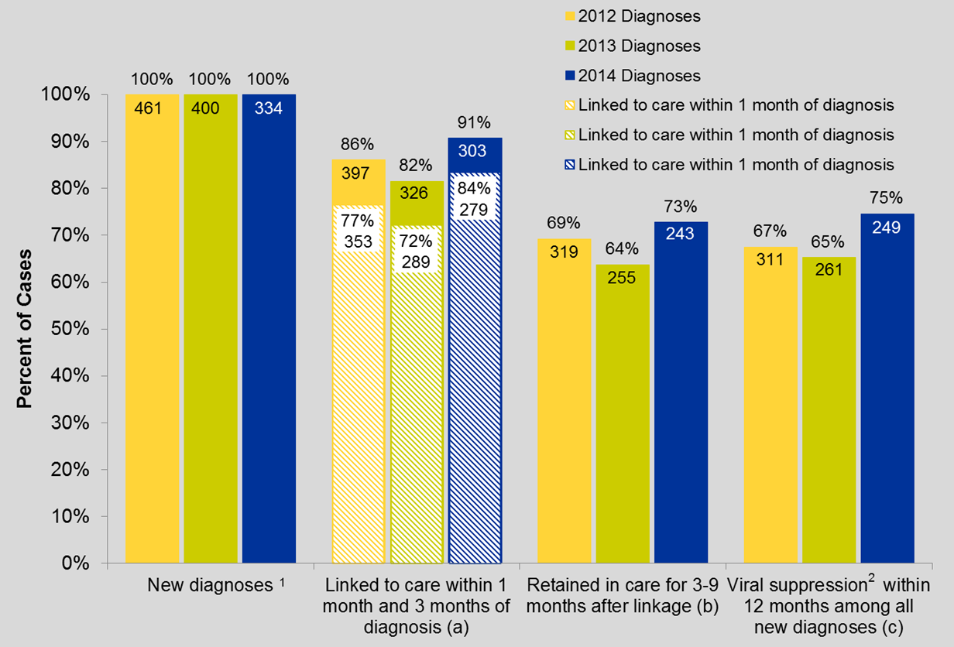
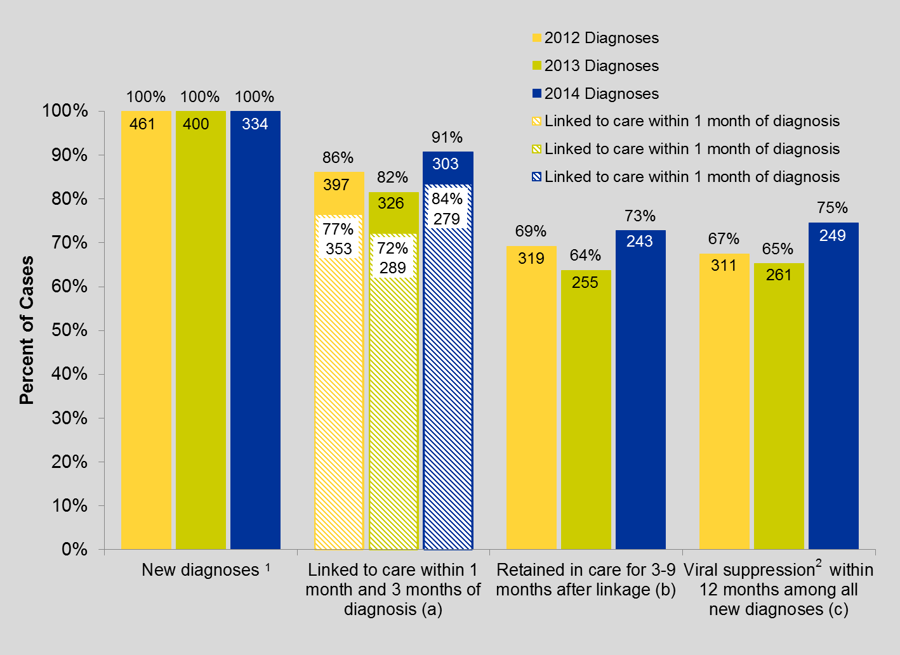
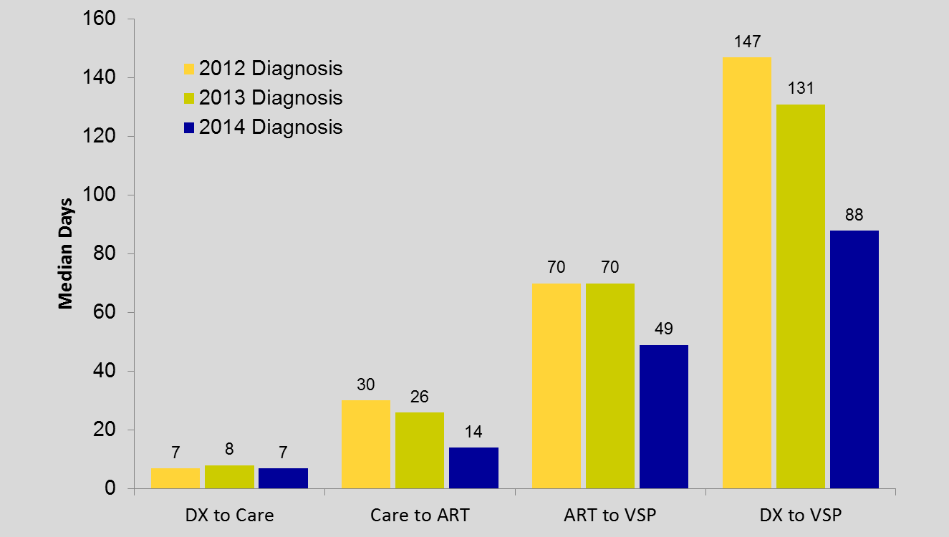
Improvements in the HIV Care Continuum

Slide 6
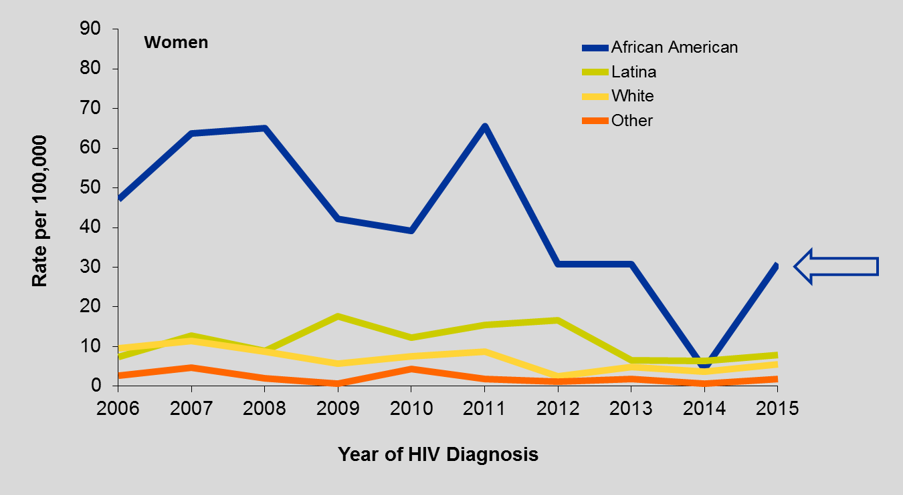
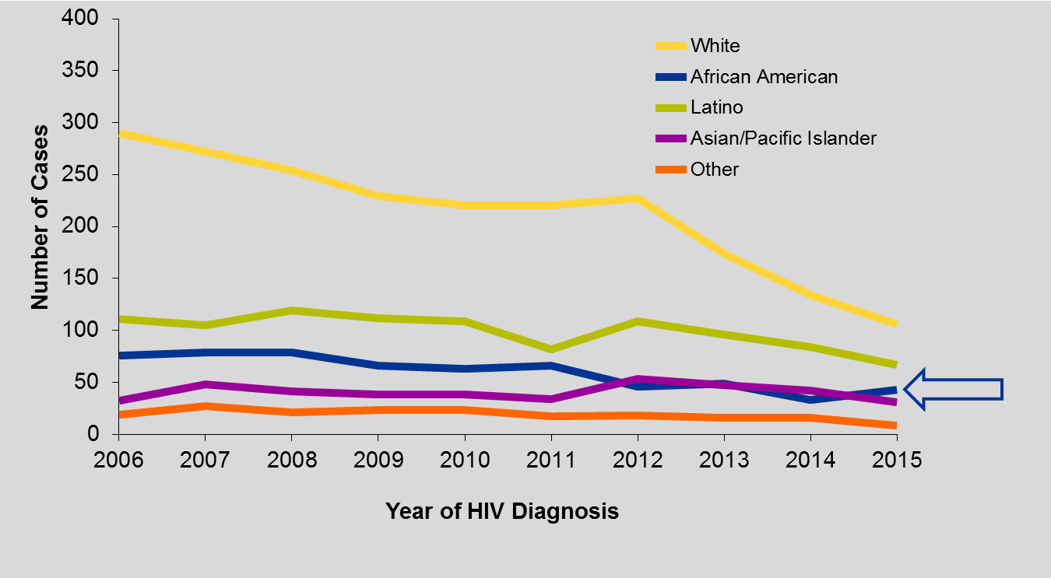
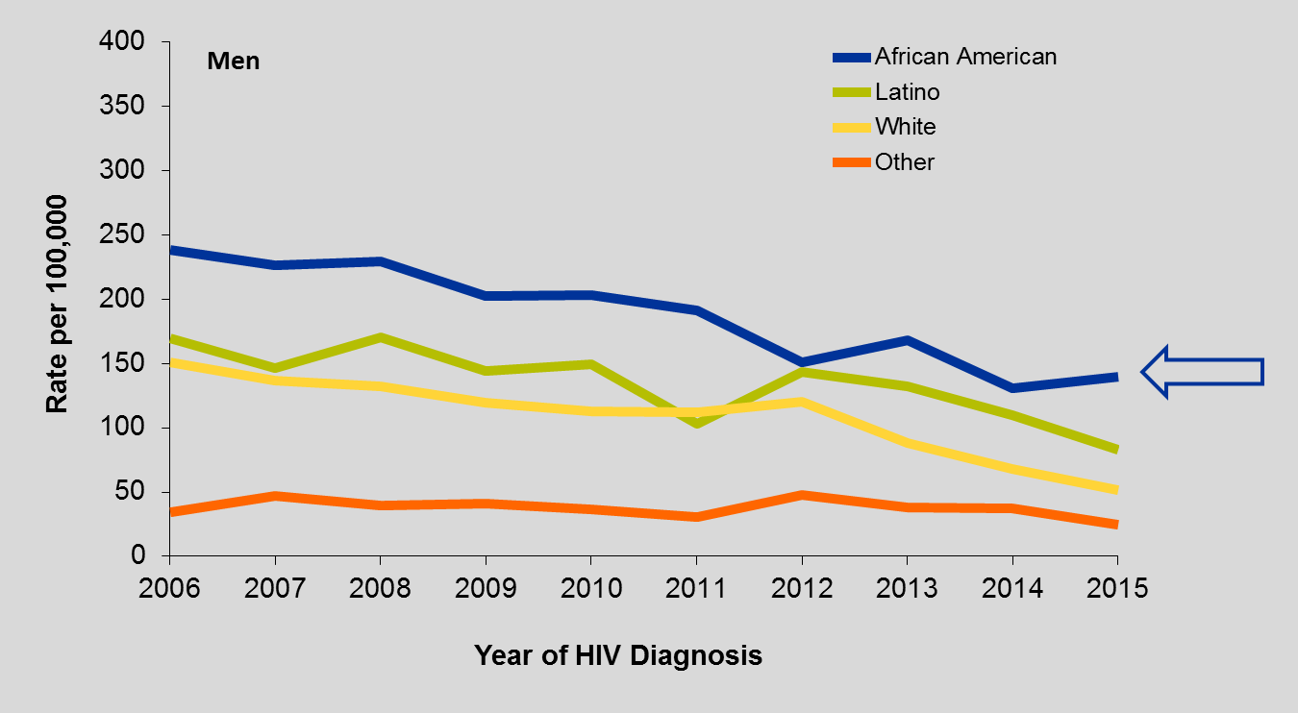
Disparities and Health Inequities:
New HIV Diagnoses
New Diagnoses among African-Americans have remained stable between 2006 and 2015; all other racial/ethnicities have seen a decline in the number of new diagnoses
African-Americans have the highest rate of HIV infection among all racial/ethnicities
People ages 30-39 are the group most likely to be diagnosed with HIV; Ages 25-29 are the second most likely
Consistently, over 70% of newly diagnosed cases are among MSM
No decline in the proportion of homeless persons diagnosed with HIV -- between 2006 to 2013 approximately 10% of all new diagnoses are among the homeless

Slide 7
Disparities and Health Inequities:
Late HIV Diagnosis by Race/Ethnicity

Slide 8
Disparities and Health Inequities:
Survival after AIDS

Slide 9
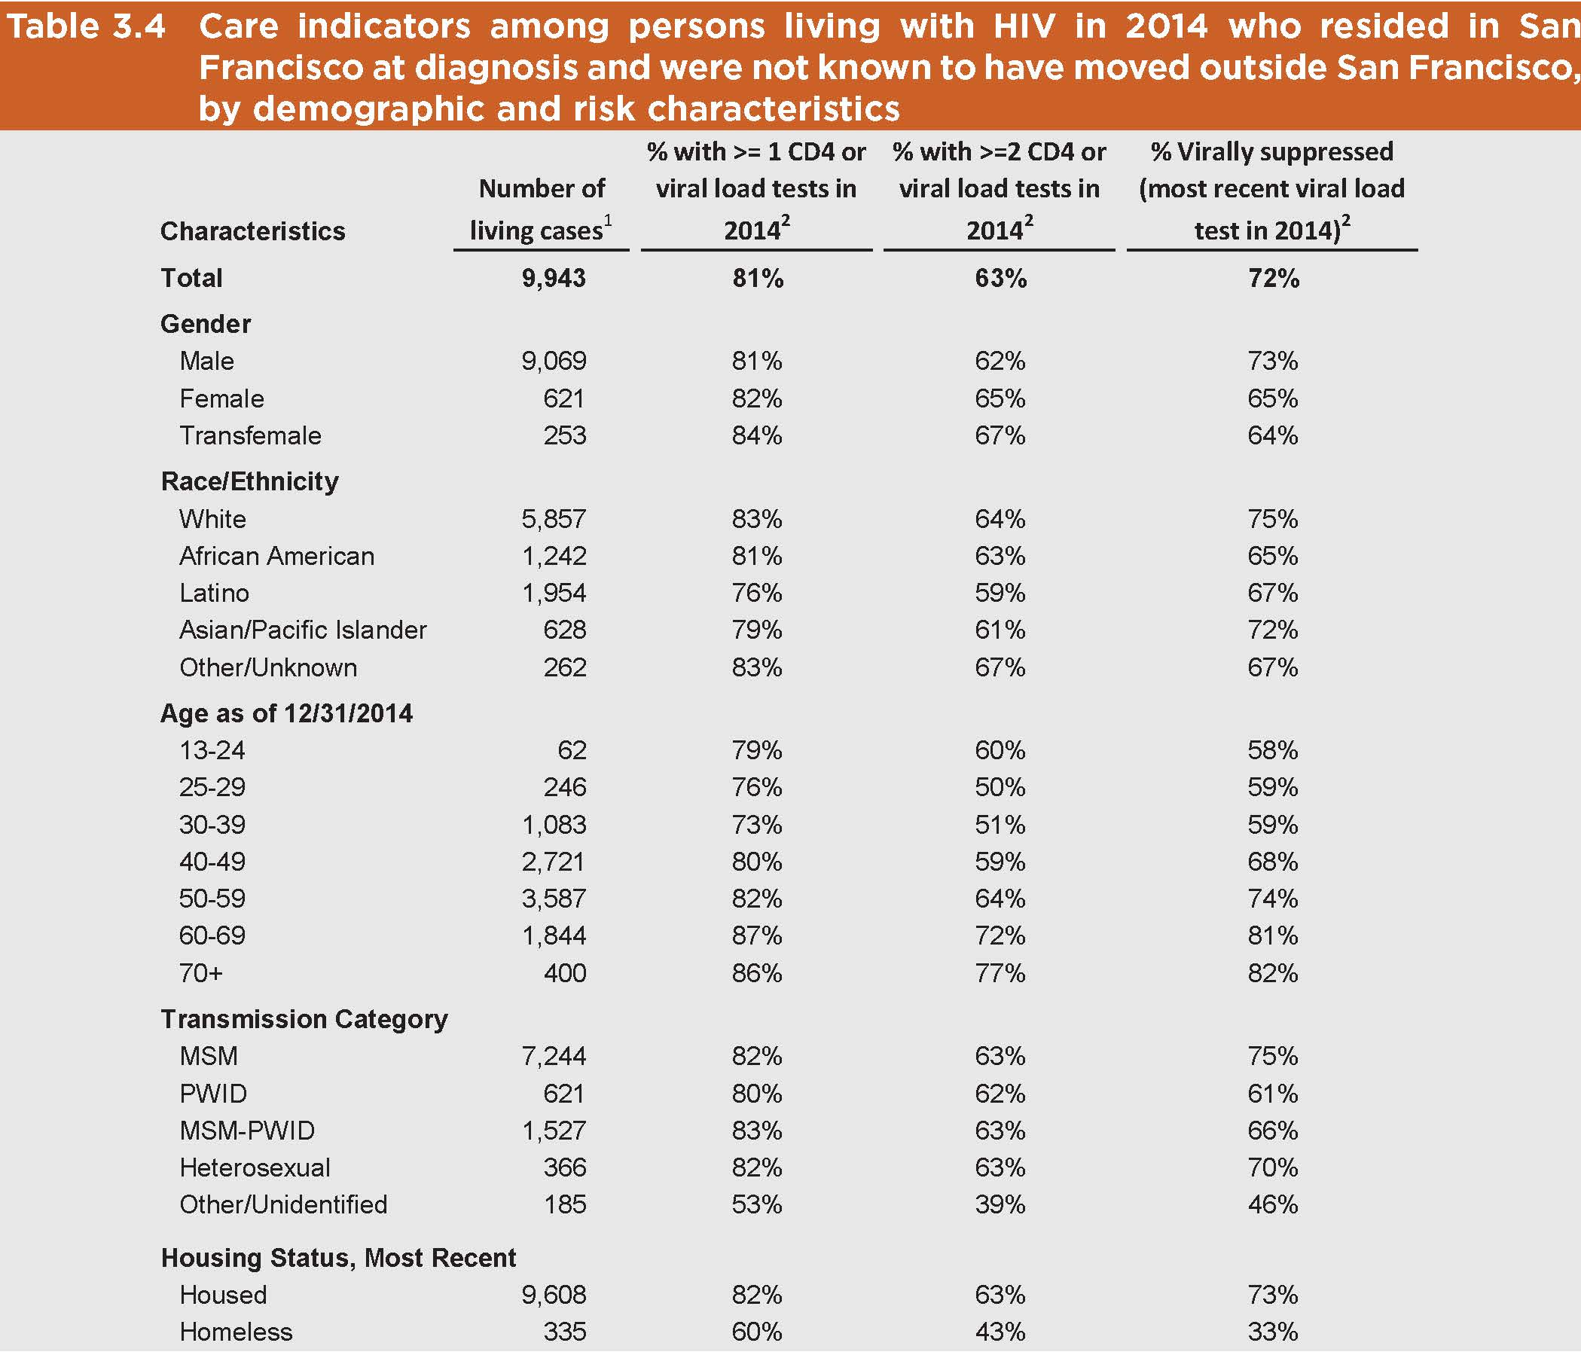
Disparities and Health Inequities: Viral Suppression

Slide 10

Getting to Zero
Addressing Unmet Needs
Zero new HIV infections
Zero HIV deaths
Zero stigma and discrimination
Notes:
#EndTheEpidemic
#GettingToZeroSF
#EndAIDSWashington

Slide 11




Strategic priorities for San Francisco Getting to Zero Consortium
City-wide coordinated PrEP program
Rapid ART start with treatment hubs
Linkage-engagement-retention in care
Reducing HIV stigma
Vision
  Become the first municipal jurisdiction in the United States to achieve the UNAIDS vision of “Getting to Zero”
Committee for each initiative is developing action plan, metrics and milestones.
HIV Prevention, Care, and Treatment Programs
Notes:
Improve health for persons at risk for or living with HIV/AIDS in San Francisco.
Emphasis on achieving health equity.
Create innovative programs and demonstrate impact with measurable objectives.
Secure multi-sector funding and support for existing and new programs.
Exchange best practices with other cities.

Slide 12
Supporting the Foundation
Population | Community Partners
Youth | Homeless Youth Alliance, Larkin Street Youth Services, San Francisco AIDS Foundation (SFAF) DREAAM
African American MSM | SFAF Black Brothers Esteem, DREAAM, Rafiki Wellness. Lyon-Martin.
Latino MSM | Instituto Familiar de la Raza, Mission Neighborhood Health Center, AGUILAS, SFAF El Grupo.
Trans women | Asian and Pacific Islander Wellness Center, El/La, St James, Instituto Familiar de la Raza, Native American AIDS Project.
People who are affected by homelessness | Homeless Youth Alliance, Glide, San Francisco AIDS Foundation.
SFDPH/City investment in HIV and GTZ is central to our efforts.

Slide 13
Increasing PrEP uptake among MSM of color, young MSM, and Trans women
Community-based
  Increase PrEP services for African American MSM, Latino MSM, young MSM, and Transwomen.
  Emergency Truvada for youth unable to use patient assistance programs.
  Pharmacy Demo Project.
SFDPH
  PrEP Coordinator and PrEP Navigator to support a Tele-PrEP program in SFDPH Primary Care.
>300 PrEP starts among these priority populations
**Award GTZ PrEP RFPs in 2017**

Slide 14
Project Pride
Increase user knowledge and interest in PrEP
  Social marketing campaign, Popular Opinion Leader
Increase linkage of focus populations to PrEP
  City-wide PrEP coordinator and navigator using innovative social media strategies
  “Data-to-PrEP”– use of STI surveillance to link patients diagnosed with rectal STIs and syphilis to PrEP
  PrEP navigators Group: share best practices
Increase primary care provider engagement in PrEP
  Public Health Detailing

Slide 15
Expand City-wide RAPID Program
Focus on providers serving MSM of color and youth.
  Evaluation of process and outcome measures, stratified by age, race/ethnicity, and gender.
Academic Detailing
  Provider training and technical assistance for RAPID hubs across SF.
LINCS RAPID Specialist
  Support RAPID implementation for all newly diagnosed patients in SF.
Decrease time from diagnosis to viral suppression.

Slide 16
Increasing Retention and
Re-engagement in Care
Increasing support services for Persons living with HIV
  Community-based Intensive Case Management (via RFP)
  Addressing Food Insecurity (via RFP)
  Increasing Employment Training (via RFP)
  In-home Support for those over 50 (via RFP)
ZSFGH PHAST Team at Ward 86
Expanded Navigation services
  LINCS Team (MAC AIDS Yr. 2)
  Data to Care
Increase viral suppression among those most likely to be out of care.

Slide 17
Addressing Stigma
Develop an anti-stigma initiative (via RFP)
  Stigma is an important barrier for HIV prevention, care, and treatment.
  Create an initiative with sustainable impact on the community and providers.
  Representation from disproportionally impacted communities: young MSM and MSM >50; MSM of color; and women at risk.
Increase capacity to address HIV-related stigma in SF.

Slide 18



















www.GettingToZeroSF.org
Steering Committee
Susan Buchbinder
Susana Cáceres
David Gonzalez
Diane Havlir
Joe Hollendoner
Jenna Rapues
Hyman Scott
Tracey Packer
Jeff Sheehy
Chip Supanich
Lance Toma
Shannon Weber
Dana van Gorder
Rafael Velazquez
Many thanks to the >200 members for all of their volunteer work!

